Slide 1
Module 5
Designing Cloud Applications for Resiliency with Design Patterns
Best practices for developing large-scale web applications
Notes:
This module focuses on the best practices for developing large-scale web applications. While the examples in this module might seem arbitrary, they do illustrate the principles that are sometimes overlooked when building large-scale web applications.
20532C
5: Designing Cloud Applications for Resiliency

Slide 2
Design Patterns
Architecture-center
https://github.com/mspnp/architecture-center/blob/master/docs/patterns/index.md

Slide 3
Application Architectures
http://learning-azure.azurewebsites.net/application-architecture/

Slide 4
Module Overview
Application Design Practices for Highly Available Applications Application Analytics Building High Performance Applications by Using ASP.NET Common Cloud Application Patterns Caching Application Data
Notes:
20532C
5: Designing Cloud Applications for Resiliency

Slide 5
Lesson 1: Application Design Practices for Highly Available Applications
Partitioning Workloads Load Balancing Transient Fault Handling Queues
Notes:
20532C
5: Designing Cloud Applications for Resiliency

Slide 6
Partitioning Workloads
When designing web applications, split your business processes into Partitioning Workloads
Partitioning Workloads:
Can be handled in modular websites, cloud services, or virtual machines
Provides the ability to scale the different components of your application in isolation
Notes:
This topic contains a very simple example to illustrate the concepts.
Examples of Issues Related to scaling with Suggested Solutions
Example 1: Many users visit your site but few register.
Solution: Scale out the web front-end and scale down the instances that host your authenticated web pages.
Example 2: Your music processing website experiences heavy traffic whenever new albums release thereby preventing other users for viewing the recently uploaded music.
Solution: Scale out or scale up the worker instance that processes music. Separate that instance from the website that allows people to view recently uploaded music.
20532C
5: Designing Cloud Applications for Resiliency

Slide 7
Partitioning Workloads (cont.)
Example Photo Sharing Application
Web Front-End
SignalR Hub
Image Processor
Virtual Machine
Thumbnail Storage
Notes:
Everything is hosted on a single virtual machine.
20532C
5: Designing Cloud Applications for Resiliency

Slide 8
Partitioning Workloads (cont.)
Example Photo Sharing Application
The Web Front-End shows thumbnails of images users have uploaded today
The application code takes an image that a user uploads, processes it into a thumbnail and then stores the thumbnail.
The SignalR hub notifies the client web browser that the image is finished processing
Notes:
20532C
5: Designing Cloud Applications for Resiliency

Slide 9
Partitioning Workloads (cont.)
Example Photo Sharing Application
Each component of the application can be scaled in isolation to meet its specific demand
Signal-R Hub
Virtual Machine
Storage Service
Thumbnail Storage and Retrieval
Website
Web Front-End
Background Worker
Image Processing
Notes:
20532C
5: Designing Cloud Applications for Resiliency

Slide 10
Load Balancing
Provide the same service from multiple instances and use a load balancer to distribute requests across all of the instances
Considerations for selecting a load balancing strategy:
Hardware or software load balancers
Load balancing algorithms (round robin)
Load balancer stickiness
Load balancing becomes critical even if you have a single service instance as it offers the capability to scale seamlessly
Notes:
20532C
5: Designing Cloud Applications for Resiliency

Slide 11
Load Balancing and Geographic Resiliency
Load balancing can be combined with geographic redundancy to help achieve high availability
You can use a load balancer to direct client requests to their closest data center
Traffic Manager is often used for this task
A load balancer can be used to implement a failover scenario
When a data center or compute instance is down, clients can be directed to the next desirable instance that is available
Designing a load balancing strategy along with distributing your application across data centers is key to high availability across the globe
Notes:
20532C
5: Designing Cloud Applications for Resiliency

Slide 12
Transient Fault Handling
Transient faults can occur because of a temporary condition
Service is unavailable
Network connectivity issue
Service is under heavy load
Retrying your request can resolve temporary issues that normally would crash an application
You can retry using different strategies
Retry after a fixed time period
Exponentially wait longer to retry
Retry in timed increments
Notes:
20532C
5: Designing Cloud Applications for Resiliency

Slide 13
Transient Fault Handling (cont.)
The Transient Fault Handling application block is a part of the Enterprise Library
The Enterprise library contains a lot of code that is necessary to implement the pattern and the retry strategies
Retry strategies are prebuilt for common scenarios including accessing Azure services
You can build custom strategies and extend the library for the unique needs of your application
Notes:
You can show a custom demonstration here if it is appropriate for your audience.
20532C
5: Designing Cloud Applications for Resiliency

Slide 14
Queues
A modular web application can behave like a monolithic application if each component relies on a direct two-way communication with a persistent connection
Persistent queue messages allow your application to handle requests if one of your application components fail or is temporary unavailable
An external queue allows your application to audit requests or measure your load without adding any overhead to the code of your primary application
Notes:
20532C
5: Designing Cloud Applications for Resiliency

Slide 15
Queues (cont.)
Queues can be used to communicate in a disconnected manner between the different components of your application
If an instance of your application module fails, another instance can process the queue messages
Messages that fail to be processed can either be reinserted into the queue or not marked as complete by the client module
Messages can be measured or audited in isolation from your application
Queues become very important when dealing with background processing (Worker roles and WebJobs)
Notes:
You might not want to spend a lot of time here. This will be covered in Module 9 – Designing a Communication Strategy by Using Queues and Service Bus.
20532C
5: Designing Cloud Applications for Resiliency

Slide 16
Lesson 2: Application Analytics
Application Insights
Notes:
20532C
5: Designing Cloud Applications for Resiliency

Slide 17
Application Insights
Application Insights is a analytics and monitoring service available for your applications
View exception stack traces
Monitor CPU and resource usage
Periodically test URLs from worldwide data centers
Monitor usage of your application and most popular requests
It can be used with .NET or Java
Applications do not specifically need to be hosted in Azure
Notes:
20532C
5: Designing Cloud Applications for Resiliency

Slide 18
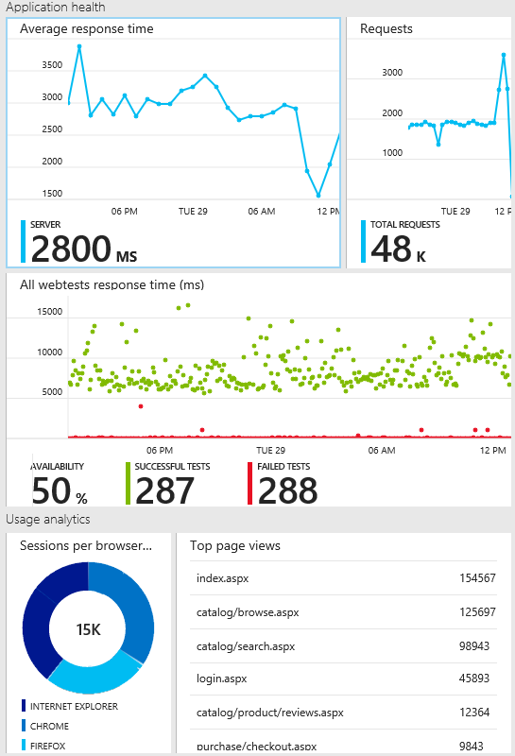
Application Insights (cont.)
The application insights blade provides a rich dashboard of data (tiles) and supports “drilling down” into more specific metrics.
Notes:
20532C
5: Designing Cloud Applications for Resiliency

Slide 19
Demonstration: Monitoring a Web Application
In this demonstration, you will learn how to:
Create a new ASP.NET Web Application project with Application Insights referenced
Use the Application Insights service and dashboard to monitor the metadata about your application’s requests
Notes:
20532C
5: Designing Cloud Applications for Resiliency

Slide 20
Lesson 3: Building High Performance Applications by Using ASP.NET
Web Hosting Performance Improvements Asynchronous HTTP Modules and Handlers The Async Keyword State Management
Notes:
20532C
5: Designing Cloud Applications for Resiliency

Slide 21
Web Hosting Performance Improvements
ASP.NET 4.5 introduced many improvements to web hosting:
Asynchronous requests and responses
Support for Task Parallel Library and await and async keywords
Sharing common assemblies across applications
Multi-core startup (JIT)
Windows prefetcher for web applications
Notes:
This is not an exhaustive list. Please refer to the course 20486 for a complete module.
20532C
5: Designing Cloud Applications for Resiliency

Slide 22
Asynchronous HTTP Modules and Handlers
Asynchronous methods in ASP.NET allow your code that is waiting for an IO-bound operation (Database, Service, Disk) to return threads to the ThreadPool
Typically these requests would block the thread from servicing other requests
By releasing threads while waiting on external factors, the amount of requests that can be processed simultaneously increases exponentially
Helps greatly with applications where the load spikes and is not generally consistent
Notes:
In the past, you would have to increase the ThreadPool count or get a HTTP 503 message.
Discussion Question: Has your application ever shown the Server Too Busy status message (HTTP 503)?
20532C
5: Designing Cloud Applications for Resiliency

Slide 23
The Async Keyword
The async and await keywords are available to create easy to read and write asynchronous methods in C#
The keywords can be used with ASP.NET MVC to create asynchronous actions:
public async Task<ActionResult> ItemsAsync() {
var context = new DatabaseContext();
var model = await context.GetModelItemsAsync();
return View(“Items”, model);
}
Notes:
20532C
5: Designing Cloud Applications for Resiliency

Slide 24
State Management
When distributing your application across multiple instances, session state needs to be shared across the instances
What happens when a user starts on Server1 but is now on Server2 when they click a link?
Session state can be moved from in-memory to a dedicated session server:
Microsoft SQL Server
ASP.NET State Server
Session state can also be partitioned and distributed among multiple session stores
Notes:
20532C
5: Designing Cloud Applications for Resiliency

Slide 25
Lesson 4: Common Cloud Application Patterns
Cloud Application Patterns The Retry Pattern The Valet Key Pattern
Notes:
20532C
5: Designing Cloud Applications for Resiliency

Slide 26
Cloud Application Patterns
MSDN provides a collection of cloud design patterns
Patterns:
Retry
Valet Key
Sharding
Notes:
20532C
5: Designing Cloud Applications for Resiliency

Slide 27
The Retry Pattern
The Retry pattern is designed to handle temporary failures
Failures are assumed to be transient until they exceed the retry policy
The Transient Fault Handling Block is an example of a library that is designed to implement the Retry pattern (and more)
Entity Framework provides a built-in retry policy implementation
Implemented in version 6.0
Notes:
Retry pattern:
Reference Links: http://go.microsoft.com/fwlink/?LinkID=510187
20532C
5: Designing Cloud Applications for Resiliency

Slide 28
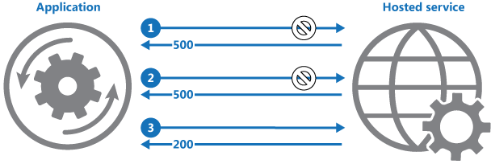
The Retry Pattern (cont.)
The application sends a request to a hosted service
The hosted service responds with a HTTP 500 (Internal Server Error) code
The application retries until it exceeds the retry count for its policy or is met with an acceptable status code such as HTTP 200 (OK)
Notes:
Discussion Question: Why would Entity Framework implement the Retry pattern?
20532C
5: Designing Cloud Applications for Resiliency

Slide 29
The Valet Key Pattern
If your application access a resource on behalf of your clients, your servers take on additional load
You do not want to make your resources publically available so you are typically forced to have your application validate a client
The Valet Key pattern dictates that your application simply validates the client and then returns a token to the client. The client can then retrieves the resource directly using its own hardware and bandwidth
Notes:
Valet Key pattern:
Reference Links: http://go.microsoft.com/fwlink/?LinkID=510188
20532C
5: Designing Cloud Applications for Resiliency

Slide 30
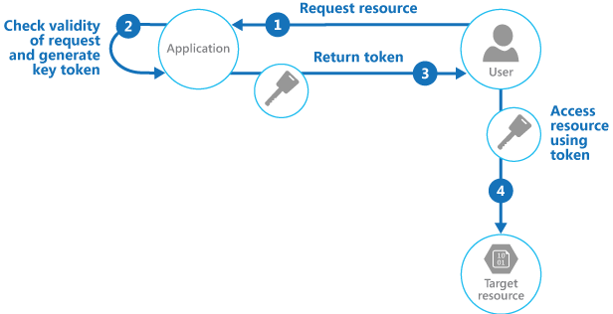
The Valet Key Pattern (cont.)
The client requests a resource from your application
Your application validates the client and then returns an access token
The client then directly accesses the resource by using the provided token
Notes:
Discussion Question: What type of resources can you access by using the Valet Key pattern?
20532C
5: Designing Cloud Applications for Resiliency

Slide 31
Lesson 5: Caching Application Data
Redis Cache
Notes:
20532C
5: Designing Cloud Applications for Resiliency

Slide 32
Redis Cache
Based on the open-source Redis platform
Multiple tiers are available that offer different numbers of nodes
Supports transactions
Supports message aggregation using a publish subscribe model
Considered a key-value store where the keys can be simple or complex values
Massive Redis ecosystem already exists with many different clients
Notes:
Redis Cache:
Reference Links: http://go.microsoft.com/fwlink/?LinkID=510192
If you have an audience who is strong with open source tooling, you should consider visiting Redis’ site and discussing the tool more in depth here.
20532C
5: Designing Cloud Applications for Resiliency

Slide 33
Module Review and Takeaways
Review Question(s)
Notes:
20532C
5: Designing Cloud Applications for Resiliency

